Slide 1
DBMS MINI PROJECT
Music Playlist
Management System
♪
A relational database for organising songs, artists, and playlists.
GROUP ID: Group 8
  TEAM MEMBER: Vedant Belsare
  PRN: 1262252826
  Division: SY BTech CSE CSF Panel A
  Batch: A2

Slide 2
01 / PROJECT OVERVIEW
The problem we're solving
THE CHALLENGE
THE APPROACH
Songs can appear in multiple playlists. Keeping titles, artists, durations, and playlist order consistent becomes difficult when information is spread across files.
Use a relational database to centralise song and artist details while preserving playlist membership and order through a linking table.
PROJECT GOAL
Design a database-backed playlist manager that supports structured storage, searching, reporting, and reliable relationships between songs, artists, and playlists.
Scope: database design, SQL operations, stored programs, and a frontend connected to MySQL.
02

Slide 3
02 / SCOPE
Objectives & core capabilities
Organise
Preserve order
01
02
Store songs, artists, and playlists in related tables.
Record each song's position inside a playlist.
Search
Report
03
04
Find songs by title and retrieve songs by artist.
Count songs and calculate playlist duration.
Designed around the existing Music Playlist Manager use case and its overlapping playlists.
03

Slide 4
03 / HOW THE PIECES CONNECT
System architecture
CSV FILES
MYSQL DATABASE
C# FRONTEND
USER
Initial song data
Tables + constraints
Windows Forms
Search + reports
DATA FLOW
Import structured playlist data into MySQL.
Use SQL queries and stored programs to retrieve or summarise information.
The frontend sends requests to MySQL and displays results to the user.
04

Slide 5
04 / DATABASE DESIGN
Entity–relationship model
PERFORMS
CONTAINS
ARTIST
SONG
PLAYLIST
1 : N
N : M
Artist_ID (PK)
Artist_Name
Song_ID (PK)
Title • Duration
Artist_ID (FK)
Playlist_ID (PK)
Playlist_Name
PLAYLIST_SONG
Playlist_ID (PK, FK)
Song_ID (PK, FK) • Position
ARTIST 1:N SONG • SONG N:M PLAYLIST. Position preserves the order of songs in each playlist.
05

Slide 6
05 / TABLES & KEYS
Relational schema
ARTIST
SONG
PLAYLIST
PLAYLIST_SONG
PK Artist_ID
Artist_Name
PK Song_ID
Title
Duration_Seconds
FK Artist_ID
PK Playlist_ID
Playlist_Name
PK/FK Playlist_ID
PK/FK Song_ID
Position
PRIMARY KEYS
FOREIGN KEYS
Each row has an identifier; PLAYLIST_SONG uses a composite key.
Links enforce valid artist, song, and playlist relationships.
Constraints also support unique names, valid durations, and unique positions within a playlist.
06

Slide 7
06 / DATABASE LAYER
SQL implementation
DDL
DML
DATA IMPORT
CREATE TABLE statements
Primary & foreign keys
UNIQUE and CHECK constraints
Queries with JOINs
Filtering and sorting
Aggregation and reports
Playlist data loaded from CSV
Song order retained
Repeated songs can be shared
EXAMPLE QUERY PATTERN
SELECT ps.position, s.title, a.artist_name, s.duration_seconds
FROM playlist_song ps JOIN song s ON ps.song_id = s.song_id
JOIN artist a ON s.artist_id = a.artist_id
WHERE ps.playlist_id = ? ORDER BY ps.position;
Parameterized values should be used by the application for safe query execution.
07

Slide 8
07 / QUERY FEATURES
What the SQL layer can answer
Playlist contents
Title search
Artist catalogue
List songs in original position order.
Find songs containing a keyword.
List songs by a selected artist.
Playlist lookup
Playlist statistics
Catalogue report
Find every playlist containing a song.
Count songs and calculate total duration.
Summarise each playlist in one result.
The project specification includes at least 10 English-language DML requirements mapped to application features.
08

Slide 9
08 / ADVANCED SQL
Stored programs & automation
2 PROCEDURES WITH CURSORS
2 FUNCTIONS
Process result rows one at a time for playlist and artist reports.
Return reusable values such as song count and total playlist duration.
2 TRIGGERS
CONSTRAINTS
Record deletion events in an audit table when a song or playlist is deleted.
Protect referential integrity and prevent invalid or duplicate relationship rows.
09

Slide 10
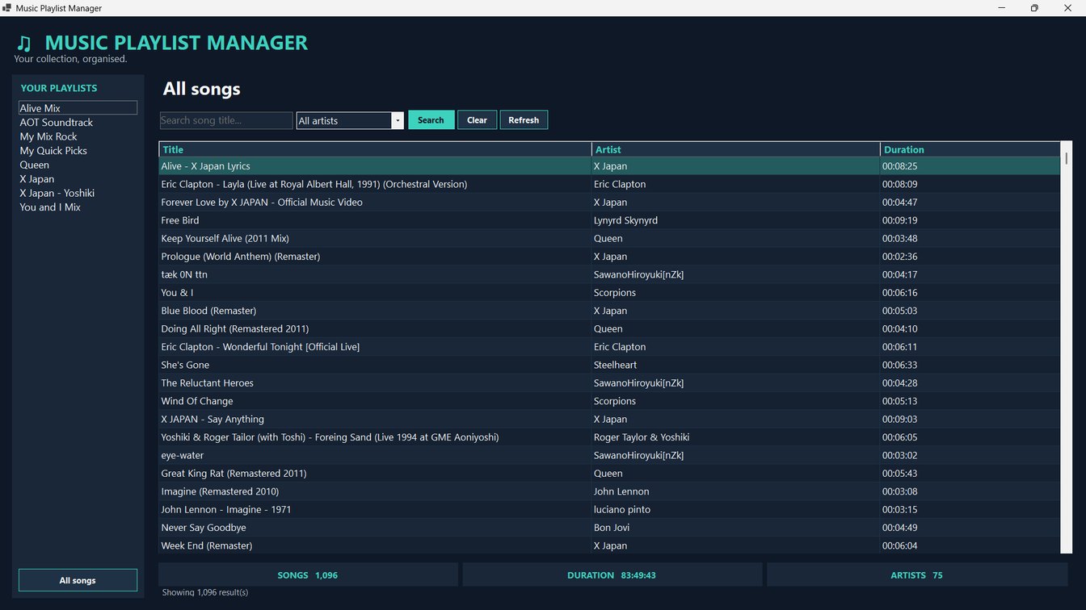
09 / APPLICATION LAYER
Frontend & demonstration workflow
DEMO FLOW
Open the application.
Load playlists from MySQL.
Select a playlist and display songs.
Search by title or artist.
Show counts and total duration.
10

Slide 11
10 / SUMMARY
One playlist collection.
A structured relational model.
The Music Playlist Management System demonstrates how relational design and SQL can organise overlapping playlists while supporting retrieval, reporting, and future GUI-based interaction.
THANK YOU

